Slide 1
TalkingData Ad Tracking and Fraud Detection
Is your digital advertising money spent on real users or click farms?
http://www.sellerdeck.co.uk/2017/08/25/buying-social-media-followers-think/
Notes:
https://www.kaggle.com/c/talkingdata-adtracking-fraud-detection
Fraud risk is everywhere, but for companies that advertise online, click fraud can happen at an overwhelming volume, resulting in misleading click data and wasted money. Ad channels can drive up costs by simply clicking on the ad at a large scale. With over 1 billion smart mobile devices in active use every month, China is the largest mobile market in the world and therefore suffers from huge volumes of fraudulent traffic.
TalkingData, China’s largest independent big data service platform, covers over 70% of active mobile devices nationwide. They handle 3 billion clicks per day, of which 90% are potentially fraudulent. Their current approach to prevent click fraud for app developers is to measure the journey of a user’s click across their portfolio, and flag IP addresses who produce lots of clicks, but never end up installing apps. With this information, they've built an IP blacklist and device blacklist.
While successful, they want to always be one step ahead of fraudsters and have turned to the Kaggle community for help in further developing their solution. In their 2nd competition with Kaggle, you’re challenged to build an algorithm that predicts whether a user will download an app after clicking a mobile app ad. To support your modeling, they have provided a generous dataset covering approximately 200 million clicks over 4 days!
Researched from forums and other discussions on Kaggle perform analysis and to create this presentation
Click farms may also be used by app developers to inflate their user metrics to fool investors and shareholders.
https://kotaku.com/inside-chinese-click-farms-1795287821

Slide 2
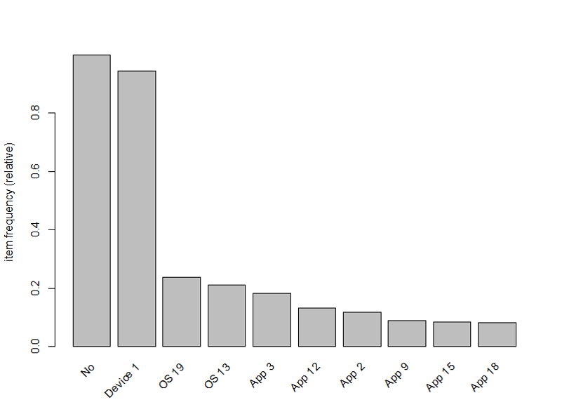
Story of clicks
Characteristics of a click – IP, device, channel, OS, app, click time, attribution time, is attributed
Frequently occurring data values in the set of 100K clicks
The original data is encoded and each variable was represented by a number/ID. It is hard to visualize/differentiate what each numbers mean, so I appended the feature name to the ID so we can tell between OS 19 and Device 19 as an example
Edited per feedback, split moving image to separate slides
Notes:
To analyze the click behavior, we have collected information like – IP, device, channel, OS, app,
click time – when the user clicked on an ad,
attribution time – when the user downloaded/purchased and
is attributed – attribution time expressed as yes/no.
Many companies use online advertising and spend a lot of money to promote targeted ads across a variety of channels, devices and vendors.
When a certain channel or vendor generates more clicks than other, we need performance measures to ensure we are spending money on the right thing

Slide 3
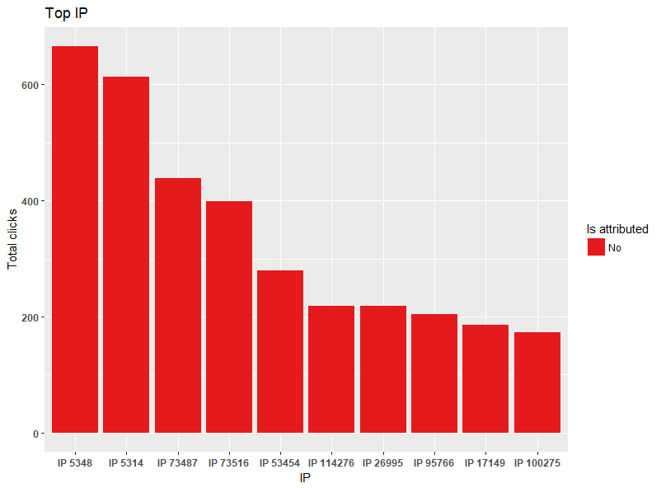
Story of clicks
Top 10 IP addresses where the clicks are coming from
IP 5348 and 5314 each have over 600 clicks and they are mostly fraudulent
Edited per feedback, split moving image to separate slides

Slide 4
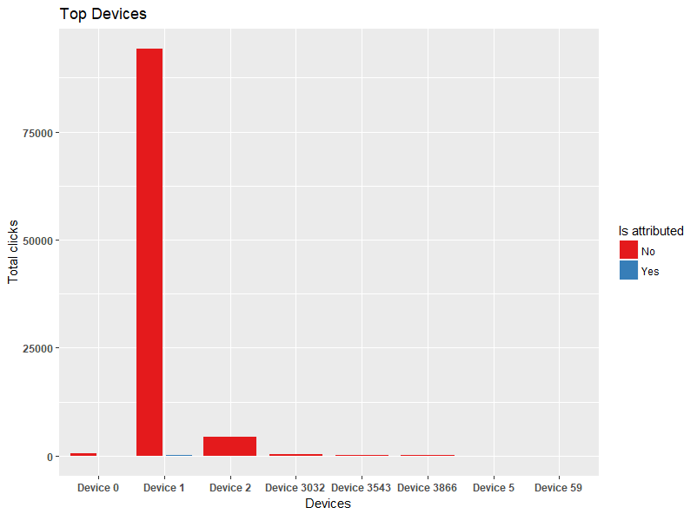
Story of clicks
Top 8 Devices where the clicks are coming from
Device 1 made over 75K clicks that are mostly fraudulent
Edited per feedback, split moving image to separate slides

Slide 5
Story of clicks
The original data is encoded to protect user data and privacy. Each variable was represented by a number/ID. It is hard to make sense of data in the form of Device 345, OS 32 etc.
As there are over 300 devices, 250 OS and 300 channels, it is hard to convert these to meaningful names.
On the other hand, encoded data makes it easy to apply this analysis to another company/ad business, specially those who are not willing to share protected data.
Care must also be taken to not misrepresent a company/device just to make the data meaningful. For e.g.: if I convert all Device 1 to iPhone 8, we may be conveying wrong information or incorrectly conclude all iPhone 8 are making fraudulent clicks.
New slide per feedback, explained the generality in dataset and removed association rules to limit time consumed
Notes:
TalkingData has provided over 200 million clicks for us to help predict whether a click will result in a download/purchase. Due to the limitation in computer processing power, I limited the dataset to a sample of 100K clicks. TalkingData provided these 100K click sample as a training sample data. I’ll try to find ways to test on the entire dataset by using parallel processing to see how well my model performed compared to other users in the Kaggle competition
In the presentation feedback there was a question if the size of the data influenced me to pick this project.
The recent Facebook senate hearing had more influence than the size of the dataset. I mainly picked this project as we can apply the models taught in class to this dataset and its an interesting problem that general public may not be aware of. This problem can be slightly modified to answer many questions:
are your social media followers real?
If you are an investor, how do you tell if a company is truly worthy of investment or is artificially boosting its client rate by hiring click farms? If you have watched Silicon Valley TV show, they use click farms to increase their user KPIs
Can be applied to a multitude of apps or companies
There was another interesting observation in the feedback – if ad selling platforms would use this tactics to charge their customer more?
Absolutely. This is one of the real problems in digital ad business. There have been multiple arrests of click framing companies in developing countries, some of them being paid by ad selling platforms. Silicon Valley TV show in #2 above is a good example

Slide 6
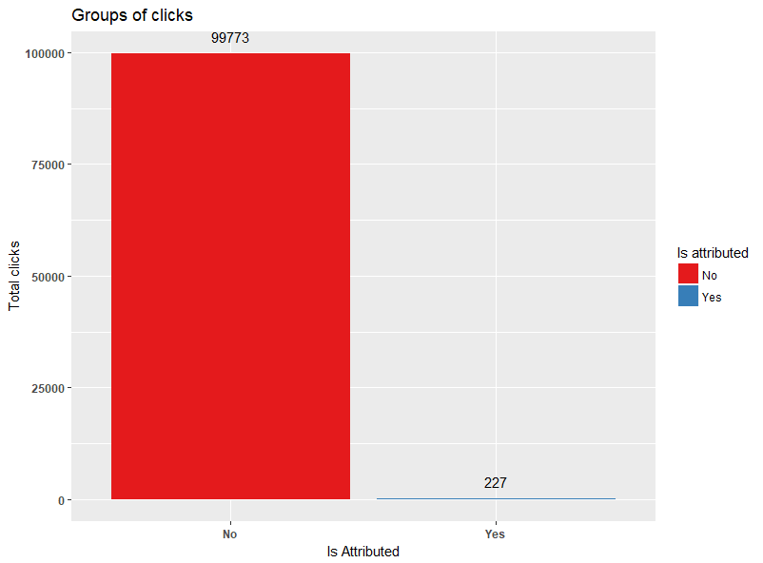
Story of clicks
At a high level there are 2 groups of clicks: clicks that result in download or purchase v/s those who don’t
Notes:
Explain the ratio of download-no download
In TalkingData intro they specified 90% fraud rate is it true in our sample? Yes

Slide 7
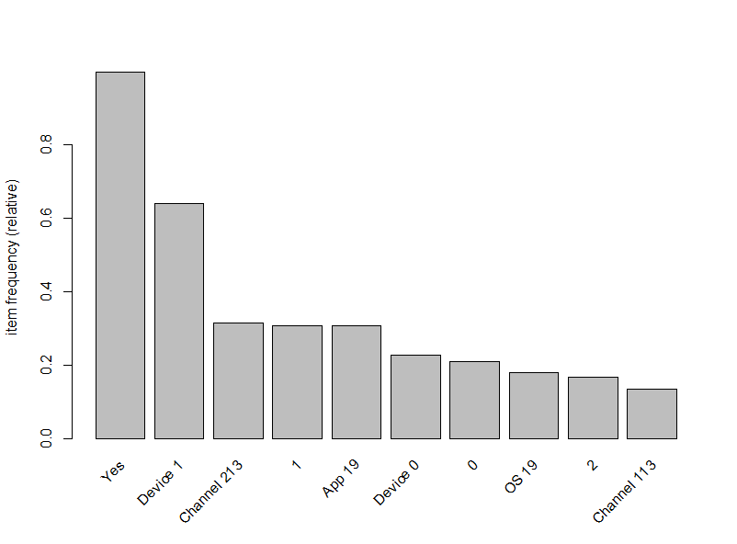
Story of real user attribution
Visualize characteristics of people who download: what channel, device, IP address, app, OS are likely to be seen in a real click
Edited per feedback, split moving image to separate slides
Notes:
EDA was performed using cluster analysis and association rules (ignored for brevity).
I used PCA to find the no. of K for cluster analysis

Slide 8
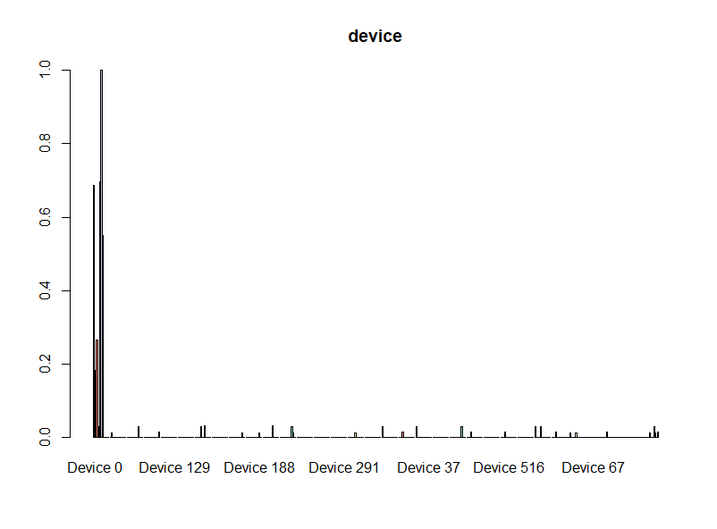
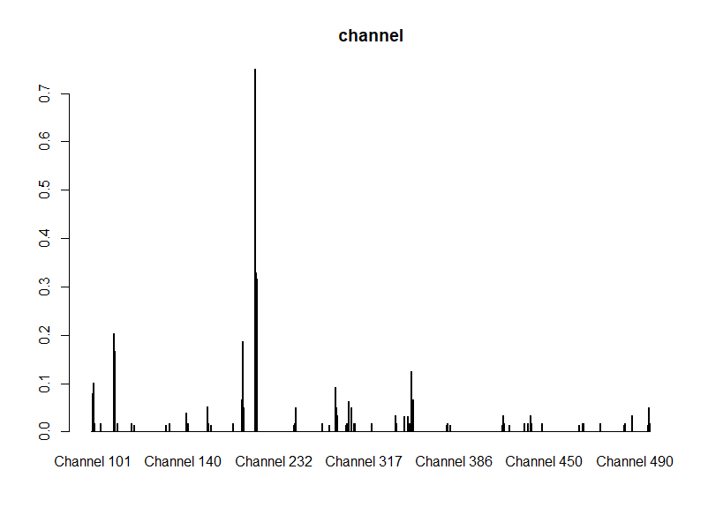
Story of real user attribution
Many of the real clicks are coming from Device 0, channel 232, channel 101 etc.
Edited per feedback, split moving image to separate slides
Notes:
There are 4 types of patterns/users in real clicks but the frequent data values is similar (e.g.: Device 0 in all groups) but with different distribution ratios.

Slide 9

Story of a fraudulent click
Visualize characteristics of people who do not download: what channel, device, IP address, app, OS are likely to be seen in a fraudulent click
Edited per feedback, split moving image to separate slides
Notes:
EDA was performed using cluster analysis and association rules (skipped in presentation)
I used PCA to find the no. of K for cluster analysis

Slide 10
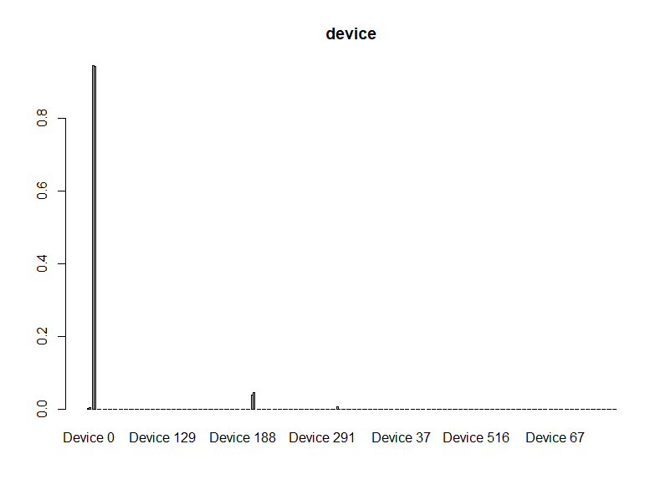
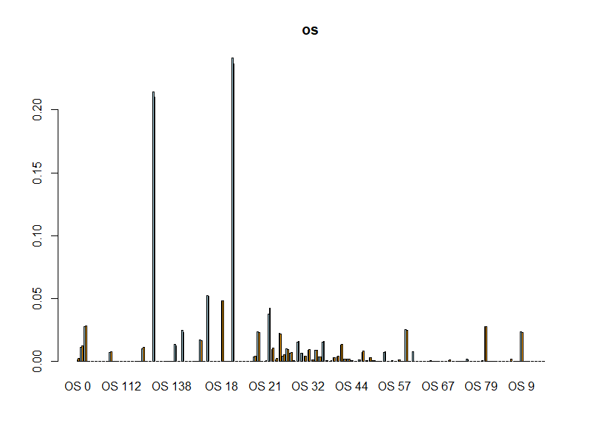
Story of a fraudulent click
Many of the fraudulent clicks are coming from Device 0, OS 138, OS 18 etc.
Edited per feedback, split moving image to separate slides
Notes:
There are 4 types of patterns/users in fraudulent clicks but the frequent data values is similar (e.g.: OS18 in both groups) but with different distribution ratios.

Slide 11
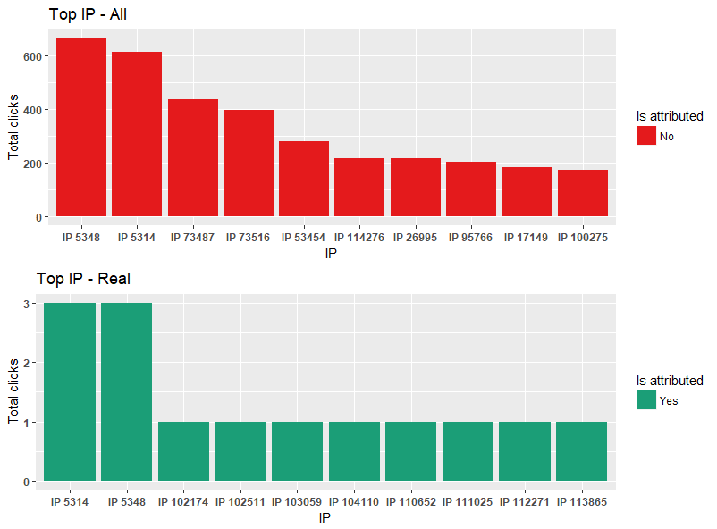
Is it really fraud or your app/ad sucks?
Today, TalkingData blacklists any IP generating too many fraud clicks
Top IPs considered as fraudulent click also have some real downloads, so is it correct to blacklist the IP?
A user may look at an ad many no. of times before actually downloading the app/making the purchase. As we only need to buy/download once (or a couple more), the frequency of real clicks is way lower than fraudulent clicks
Edited per feedback, split moving image to separate slides

Slide 12
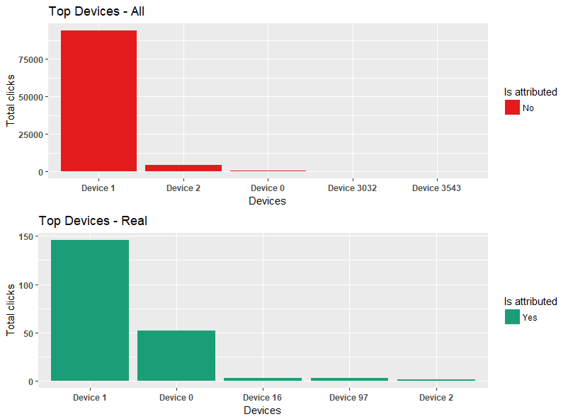
Is it really fraud or your app/ad sucks?
Today, TalkingData blacklists any device type that generates too many fraudulent clicks
Top Devices considered as fraudulent click also have some real downloads, so is it correct to blacklist the Device?
Edited per feedback, split moving image to separate slides
Notes:
Explain the ratio of download-no download
In TalkingData intro they specified 90% fraud rate is it true in our sample?

Slide 13
Is it really fraud or your app/ad sucks?
IP addresses 5348 and 5314 may belong to a university or corporation where there are a large no. of users.
Device 1 may be an iPhone version that millions of people in the world use. (image in previous slide)
Based on these observations, how do we decide if a click is really fraudulent or your app/ad is failing in client conversion
Edited per feedback, split moving image to separate slides, explained difference b/w real and fake clicks with same device no. or IP address

Slide 14
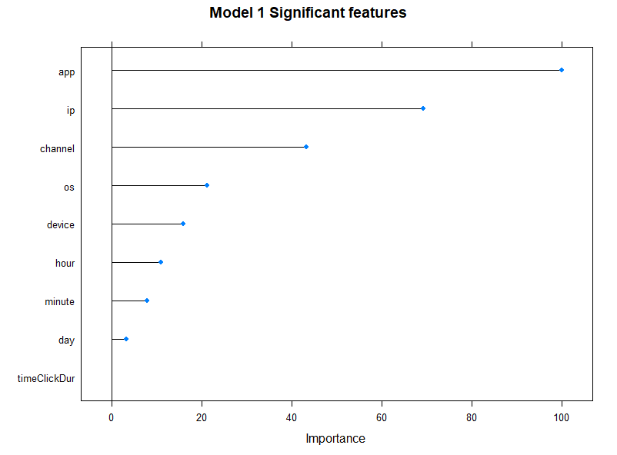
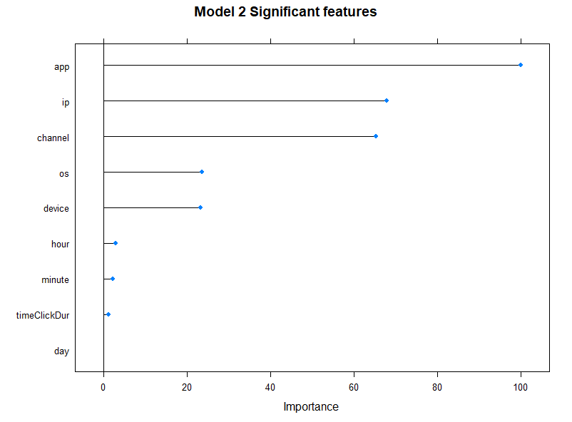
Predict attribution and spend your money better Statistically significant variables for each model – notice how the time of click is not important in both models. We have data from only 3 days and it doesn’t significantly influence whether it is a real/fake click Edited added text that I explained in class but was not part of the slide
Notes:
We cannot eliminate any single IP or device as fraud without looking at rest of the data. The comparison above shows important features in predicting a real vs fraudulent click and the weights assigned to each of them

Slide 15
Unbalanced predictor
Over 90% of clicks are fraudulent, only 10% of clicks resulted in download/purchase
Models learn from the data available and therefore can predict ‘No’ with high accuracy as there is a lot of fraudulent clicks
How to improve accuracy in predicting real clicks?
Notes:
Our models will perform extremely well at classifying ‘No’ but poorly in ‘Yes’ as the training data is not sufficient to learn

Slide 16
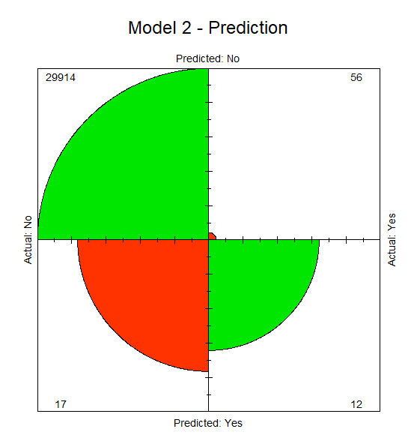
Model tuning to improve accuracy
The image shows the predictions of our original model, we are comparing how many clicks are correctly classified as real/fraudulent
Green indicates the no. of clicks that are correctly predicted. The click was real and we identified it as real or the click was fraudulent and we identified it as fraudulent
Red indicates the no. of clicks that we predicted wrong. The click was misclassified – real as fraudulent or vice versa
Our goal in this exercise is to get better at identifying the real users – bottom right corner, while not losing too much accuracy in the top left corner – fraudulent users
New slide per feedback, explain red and green circle chart
Notes:
Our models will perform extremely well at classifying ‘No’ but poorly in ‘Yes’ as the training data is not sufficient to learn
I used caret package to train the models – NB (Model 1) and DT (Model 2). I performed various samplings on both NB and DT to see which one performs better. Some of the samplings used – down sampling, over sampling and synthesized over sampling (SMOTE)
The proportion of green vs red in the image is confusing as 56 is higher than 12, but it is based on total no of observations and % correct in each type – real/fraud. I couldn’t find any detailed explanation on how the fourfoldplot decides on the size of each section

Slide 17
Model tuning to improve accuracy
Help the model by increasing the no. of Yes/real clicks - oversampling
Help the model by decreasing the no. of No/fraudulent clicks – down sampling
Train the models with repeated validation to find one with best accuracy
Edited per feedback, how I dealt with unbalanced panels, I decided to keep the moving image in just this slide as I’m not explaining each sample in detail but these are the results of various sampling/tuning applied. The results of the sampling vary in each run, the final knit document is different from what is presented here
Notes:
Our models will perform extremely well at classifying ‘No’ but poorly in ‘Yes’ as the training data is not sufficient to learn
I used caret package to train the models – NB and DT. I performed various samplings on both NB and DT to see which one performs better. Some of the samplings used – down sampling, over sampling and synthesized over sampling (SMOTE)

Slide 18
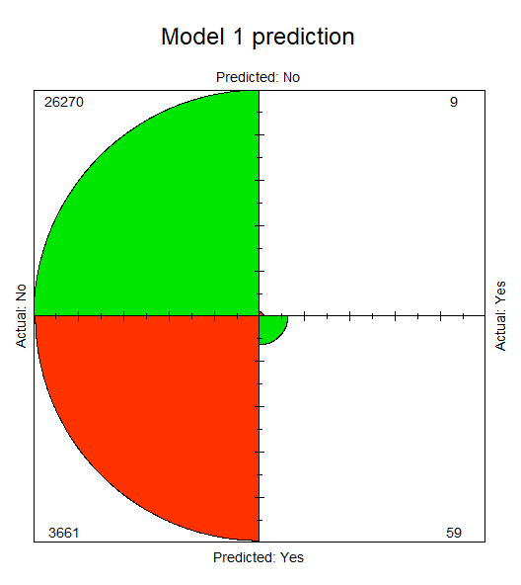

Comparing predictive accuracy of the selected approaches 86% or 92%? Model 1 misclassified many fraudulent clicks as real and therefore has less overall accuracy than Model 2. Even though model 1 is less accurate, it is doing a better job at classifying real clicks. Therefore, this fits our business problem. Edited per feedback explain difference in model 1 and 2 in final slide
Notes:
Model 1 has higher no. of Yes, so better ROC/AUC
Model 2 overall accuracy is better, but relatively smaller AUC
While model 1 is less accurate than model 2, it is doing a better job at identifying the real users, so this is a better model for our business problem
Final selection of models -- NB performed well in oversampling and DT performed well in down sampling

Slide 19
Questions?
For technical details and code sample please visit https://github.com/ashata
(after May 5)

